Slide 2
Pharmacokinetics of dolutegravir 5mg dispersible tablets in children weighing 6 to <20kg dosed using WHO weight bands
ODYSSEY
H. Waalewijn, P.D.J. Bollen, C. Moore, A. Kekitiinwa, P. Amuge, H. Mujuru, E. Chidziva, V. Musiime, E. Kaudha, A. Lugemwa, S. Makumbi, A. Violari, E. Variava, S. Ali, C. Giaquinto, P. Rojo, A. Colbers, D.M. Gibb, D. Ford, A. Turkova, D. Burger, and the ODYSSEY trial team
@TwitterHandle
Share your thoughts on this presentation with #IAS2019

Slide 3
Disclosures
ODYSSEY
The trial is sponsored by Penta Foundation
ViiV Healthcare funded the main trial and PK substudies
The funder had no direct role in the study design, data collection, analysis, interpretation, or the decision to submit for this conference

Slide 4
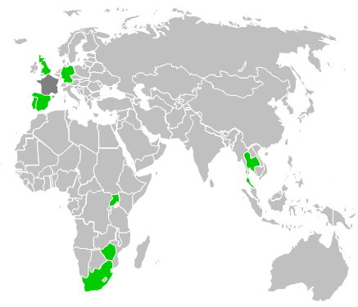
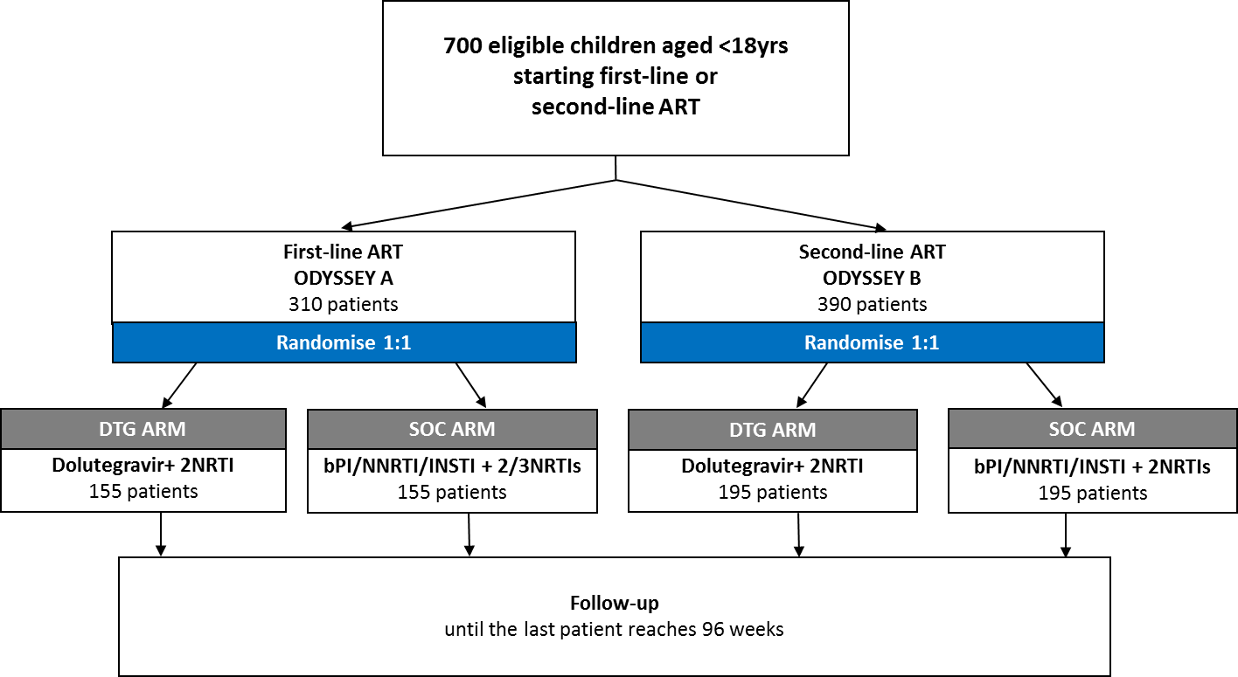
Background
ODYSSEY is a randomised, non-inferiority trial evaluating efficacy and safety of 1st and 2nd line dolutegravir-based ART vs standard of care in HIV-infected children <18 years
700 children ≥14kg
Additional 80 children <14kg (recruitment ongoing)

Slide 5
Dosing table
WHO Weight bands, kg | DTG DT* once daily number of tablets and daily dose, mg
3 to <6 (<6 months old)** | 1 (5mg)
3 to <6 (>6 months old)** | 2 (10mg)
6 to <10 | 3 (15mg)
10 to <14 | 4 (20mg)
14 to <20 | 5 (25mg)
20 to <25** | 6 (30mg)
*Dolutegravir dispersible tablet (DT) formulation; DT are ~1.6 to 2.0x more bioavailable than film coated tablets (FCT)
**Not part of this presentation; 20 to <25kg data presented at CROI 2019 by Bollen et al.

Slide 6
PK reference values
ODYSSEY
C_{trough:} Comparable to adult data on 50mg FCT QD
Individual levels above EC₉₀ (0.32 mg/L) and/or IC₉₀ (0.06 mg/L)
C_{max} Compared to adult data on 50mg BID
AUC Compared to adult data on QD and BID
Adult reference values
 |  | Min et al. AIDS 2011 | VIKING-3*
Weight band |  | ≥ 40kg | ≥ 40kg
Dose | Mg | 50 FCT QD | 50 FCT BID
N |  | 10 | 24
C_{trough} (CV%) | mg/L | 0.83 (26) | 2.72 (70)
AUC_{0-24h} (CV%) | mg*h/L | 43.4 (20) | 93.4 (50)
C_{max} (CV%) | mg/L | 3.34 (16) | 5.41 (40)
* ViiV data available on Clinicaltrials.gov id: NCT00950859

Slide 7
PK reference values
ODYSSEY
C_{trough:} Comparable to adult data on 50mg FCT QD
Individual levels above EC₉₀ (0.32 mg/L) and/or IC₉₀ (0.06 mg/L)
C_{max} Compared to adult data on 50mg BID
AUC Compared to adult data on QD and BID
Adult reference values
 |  | Min et al. AIDS 2011 | VIKING-3*
Weight band |  | ≥ 40kg | ≥ 40kg
Dose | Mg | 50 FCT QD | 50 FCT BID
N |  | 10 | 24
C_{trough} (CV%) | mg/L | 0.83 (26) | 2.72 (70)
AUC_{0-24h} (CV%) | mg*h/L | 43.4 (20) | 93.4 (50)
C_{max} (CV%) | mg/L | 3.34 (16) | 5.41 (40)
* ViiV data available on Clinicaltrials.gov id: NCT00950859

Slide 8
PK reference values
ODYSSEY
C_{trough:} Comparable to adult data on 50mg FCT QD
Individual levels above EC₉₀ (0.32 mg/L) and/or IC₉₀ (0.06 mg/L)
C_{max} Compared to adult data on 50mg BID
AUC Compared to adult data on QD and BID
Adult reference values
 |  | Min et al. AIDS 2011 | VIKING-3*
Weight band |  | ≥ 40kg | ≥ 40kg
Dose | Mg | 50 FCT QD | 50 FCT BID
N |  | 10 | 24
C_{trough} (CV%) | mg/L | 0.83 (26) | 2.72 (70)
AUC_{0-24h} (CV%) | mg*h/L | 43.4 (20) | 93.4 (50)
C_{max} (CV%) | mg/L | 3.34 (16) | 5.41 (40)
* ViiV data available on Clinicaltrials.gov id: NCT00950859

Slide 9
PK reference values
ODYSSEY
C_{trough:} Comparable to adult data on 50mg FCT QD
Individual levels above EC₉₀ (0.32 mg/L) and/or IC₉₀ (0.06 mg/L)
C_{max} Compared to adult data on 50mg BID
AUC Compared to adult data on QD and BID
Adult reference values
 |  | Min et al. AIDS 2011 | VIKING-3*
Weight band |  | ≥ 40kg | ≥ 40kg
Dose | Mg | 50 FCT QD | 50 FCT BID
N |  | 10 | 24
C_{trough} (CV%) | mg/L | 0.83 (26) | 2.72 (70)
AUC_{0-24h} (CV%) | mg*h/L | 43.4 (20) | 93.4 (50)
C_{max} (CV%) | mg/L | 3.34 (16) | 5.41 (40)
* ViiV data available on Clinicaltrials.gov id: NCT00950859

Slide 10
Methods
ODYSSEY
Steady-state 24h PK curves were constructed after DTG DT given for ≥7 days
Taking DTG with food increases absorption
Quantification method: Liquid Chromatography-Mass spectrometry
PK analysis: Non-compartmental analysis (WinNonLin)
PK-sampling: Samples taken at t=0 (prior to DTG dose), t= 1, 2, 3, 4, 6 and 24h
Fasting <10kg | Fasting ≥10kg
2-hr fast pre- and 1-hr post dose preferred but not obligatory* | Overnight fast (preferred) or minimum 3 hrs fasted pre-dose
*All but one child was able to fast successfully

Slide 11
Results
ODYSSEY
41 black-African children from Uganda, Zimbabwe and South Africa
Uganda: JCRC Lubowa, JCRC Mbarara, Baylor
Zimbabwe: UZCRC
South Africa: Soweto, Klerksdorp-Tshepong Hospital Complex
34 children had evaluable PK curves
7 were not evaluable due to non-adherence (3), incorrect dose (1), not fasted (1), previous dose not taken within dosing window (1), prohibited comedication (1)
Weight band | N | Median (IQR) age (y) | Median (IQR) weight (kg) | n/N (%) male
6-<10kg | 11 | 1.4 (0.9-2.0) | 8.4 (7.0-9.0) | 3/11 (27%)
10-<14kg | 10 | 2.4 (2.0-3.3) | 11.2 (10.3-12.0) | 3/10 (30%)
14-<20kg | 13 | 6.0 (5.2-6.8) | 18.0 (15.9-18.5) | 7/13 (54%)
Total | 34 | 3.1 (2.0-5.6) | 11.5 (9.0-17.0) | 13/34 (38%)

Slide 12
Results
 |  | ODYSSEY Weight Bands |  |  | Reference adults
WHO weight band |  | 6-<10 | 10-<14 | 14-<20 | ≥ 40kg | ≥ 40kg
Dose | (mg) and formulation | 15 DT | 20 DT | 25 DT | 50 FCT QD* | 50 FCT BID**
N |  | 11 | 10 | 13 | 10ª | 24^{b}
Dose/weight (range) | mg/kg | 1.8 (1.5-2.2) | 1.8 (1.6-2.0) | 1.4 (1.3-1.7) | - | -
C_{trough} (CV%) | mg/L | 0.48 (167) | 0.82 (55) | 0.85 (67) | 0.83 (26)ª | 2.72 (70)^{b}
AUC_{0-24h} (CV%) | mg*h/L | 49.3 (77) | 77.0 (22) | 69.5 (30) | 43.4 (20)ª | 93.4 (50)^{b}
C_{max} (CV%) | mg/L | 5.4 (50) | 8.0 (22) | 7.1 (21) | 3.3 (16)ª | 5.4 (40)^{b}
Pharmacokinetic parameters are expressed as geometric mean with coefficient of variation (%), and median (range) for dose/weight. FCT, film-coated tablet; DT, dispersible tablet. ªFasted HIV-positive adults. ^{b}HIV-positive treatment experienced adults, fed state not specified.
*Min et al. AIDS 2011
** ViiV data available on Clinicaltrials.gov ref.: NCT00950859

Slide 13
Results
 |  | ODYSSEY Weight Bands |  |  | Reference adults
WHO weight band |  | 6-<10 | 10-<14 | 14-<20 | ≥ 40kg | ≥ 40kg
Dose | (mg) and formulation | 15 DT | 20 DT | 25 DT | 50 FCT QD* | 50 FCT BID**
N |  | 11 | 10 | 13 | 10ª | 24^{b}
Dose/weight (range) | mg/kg | 1.8 (1.5-2.2) | 1.8 (1.6-2.0) | 1.4 (1.3-1.7) | - | -
C_{trough} (CV%) | mg/L | 0.48 (167) | 0.82 (55) | 0.85 (67) | 0.83 (26)ª | 2.72 (70)^{b}
AUC_{0-24h} (CV%) | mg*h/L | 49.3 (77) | 77.0 (22) | 69.5 (30) | 43.4 (20)ª | 93.4 (50)^{b}
C_{max} (CV%) | mg/L | 5.4 (50) | 8.0 (22) | 7.1 (21) | 3.3 (16)ª | 5.4 (40)^{b}
Pharmacokinetic parameters are expressed as geometric mean with coefficient of variation (%), and median (range) for dose/weight. FCT, film-coated tablet; DT, dispersible tablet. ªFasted HIV-positive adults. ^{b}HIV-positive treatment experienced adults, fed state not specified.
*Min et al. AIDS 2011
** ViiV data available on Clinicaltrials.gov ref.: NCT00950859

Slide 14
Results
 |  | ODYSSEY Weight Bands |  |  | Reference adults
WHO weight band |  | 6-<10 | 10-<14 | 14-<20 | ≥ 40kg | ≥ 40kg
Dose | (mg) and formulation | 15 DT | 20 DT | 25 DT | 50 FCT QD* | 50 FCT BID**
N |  | 11 | 10 | 13 | 10ª | 24^{b}
Dose/weight (range) | mg/kg | 1.8 (1.5-2.2) | 1.8 (1.6-2.0) | 1.4 (1.3-1.7) | - | -
C_{trough} (CV%) | mg/L | 0.48 (167) | 0.82 (55) | 0.85 (67) | 0.83 (26)ª | 2.72 (70)^{b}
AUC_{0-24h} (CV%) | mg*h/L | 49.3 (77) | 77.0 (22) | 69.5 (30) | 43.4 (20)ª | 93.4 (50)^{b}
C_{max} (CV%) | mg/L | 5.4 (50) | 8.0 (22) | 7.1 (21) | 3.3 (16)ª | 5.4 (40)^{b}
Pharmacokinetic parameters are expressed as geometric mean with coefficient of variation (%), and median (range) for dose/weight. FCT, film-coated tablet; DT, dispersible tablet. ªFasted HIV-positive adults. ^{b}HIV-positive treatment experienced adults, fed state not specified.
*Min et al. AIDS 2011
** ViiV data available on Clinicaltrials.gov ref.: NCT00950859

Slide 15
C_{trough}
4/11 (36%) had C_{trough} values below EC₉₀ (0.32 mg/L)
All C_{trough} values remained above IC₉₀ (0.06 mg/L)
ODYSSEY
C_{trough} 6 to <10kg

Slide 16
C_{trough}
Geometric Mean C_{trough} similar to adults
ODYSSEY
C_{trough} 10 to <14kg

Slide 17
C_{trough}
Geometric Mean C_{trough} similar to adults
ODYSSEY
C_{trough} 14 to <20kg

Slide 18
Results
 |  | ODYSSEY Weight Bands |  |  | Reference adults
WHO weight band |  | 6-<10 | 10-<14 | 14-<20 | ≥ 40kg | ≥ 40kg
Dose | (mg) and formulation | 15 DT | 20 DT | 25 DT | 50 FCT QD* | 50 FCT BID**
N |  | 11 | 10 | 13 | 10ª | 24^{b}
Dose/weight (range) | mg/kg | 1.8 (1.5-2.2) | 1.8 (1.6-2.0) | 1.4 (1.3-1.7) | - | -
C_{trough} (CV%) | mg/L | 0.48 (167) | 0.82 (55) | 0.85 (67) | 0.83 (26)ª | 2.72 (70)^{b}
AUC_{0-24h} (CV%) | mg*h/L | 49.3 (77) | 77.0 (22) | 69.5 (30) | 43.4 (20)ª | 93.4 (50)^{b}
C_{max} (CV%) | mg/L | 5.4 (50) | 8.0 (22) | 7.1 (21) | 3.3 (16)ª | 5.4 (40)^{b}
Pharmacokinetic parameters are expressed as geometric mean with coefficient of variation (%), and median (range) for dose/weight. FCT, film-coated tablet; DT, dispersible tablet. ªFasted HIV-positive adults. ^{b}HIV-positive treatment experienced adults, fed state not specified.
*Min et al. AIDS 2011
** ViiV data available on Clinicaltrials.gov ref.: NCT00950859

Slide 19
Results
 |  | ODYSSEY Weight Bands |  |  | Reference adults
WHO weight band |  | 6-<10 | 10-<14 | 14-<20 | ≥ 40kg | ≥ 40kg
Dose | (mg) and formulation | 15 DT | 20 DT | 25 DT | 50 FCT QD* | 50 FCT BID**
N |  | 11 | 10 | 13 | 10ª | 24^{b}
Dose/weight (range) | mg/kg | 1.8 (1.5-2.2) | 1.8 (1.6-2.0) | 1.4 (1.3-1.7) | - | -
C_{trough} (CV%) | mg/L | 0.48 (167) | 0.82 (55) | 0.85 (67) | 0.83 (26)ª | 2.72 (70)^{b}
AUC_{0-24h} (CV%) | mg*h/L | 49.3 (77) | 77.0 (22) | 69.5 (30) | 43.4 (20)ª | 93.4 (50)^{b}
C_{max} (CV%) | mg/L | 5.4 (50) | 8.0 (22) | 7.1 (21) | 3.3 (16)ª | 5.4 (40)^{b}
Pharmacokinetic parameters are expressed as geometric mean with coefficient of variation (%), and median (range) for dose/weight. FCT, film-coated tablet; DT, dispersible tablet. ªFasted HIV-positive adults. ^{b}HIV-positive treatment experienced adults, fed state not specified.
*Min et al. AIDS 2011
** ViiV data available on Clinicaltrials.gov ref.: NCT00950859

Slide 20
C_{max}
ODYSSEY

Slide 21
Results
 |  | ODYSSEY Weight Bands |  |  | Reference adults
WHO weight band |  | 6-<10 | 10-<14 | 14-<20 | ≥ 40kg | ≥ 40kg
Dose | (mg) and formulation | 15 DT | 20 DT | 25 DT | 50 FCT QD* | 50 FCT BID**
N |  | 11 | 10 | 13 | 10ª | 24^{b}
Dose/weight (range) | mg/kg | 1.8 (1.5-2.2) | 1.8 (1.6-2.0) | 1.4 (1.3-1.7) | - | -
C_{trough} (CV%) | mg/L | 0.48 (167) | 0.82 (55) | 0.85 (67) | 0.83 (26)ª | 2.72 (70)^{b}
AUC_{0-24h} (CV%) | mg*h/L | 49.3 (77) | 77.0 (22) | 69.5 (30) | 43.4 (20)ª | 93.4 (50)^{b}
C_{max} (CV%) | mg/L | 5.4 (50) | 8.0 (22) | 7.1 (21) | 3.3 (16)ª | 5.4 (40)^{b}
Pharmacokinetic parameters are expressed as geometric mean with coefficient of variation (%), and median (range) for dose/weight. FCT, film-coated tablet; DT, dispersible tablet. ªFasted HIV-positive adults. ^{b}HIV-positive treatment experienced adults, fed state not specified.
*Min et al. AIDS 2011
** ViiV data available on Clinicaltrials.gov ref.: NCT00950859

Slide 22
AUC between adult QD and BID values
ODYSSEY

Slide 23
ODYSSEY and IMPAACT P1093
ODYSSEY
Laboratories are linked through a Quality Control program

Slide 24
Discussion and conclusion
ODYSSEY
DTG DT in children weighing 10-<14kg &14 -<20kg, dosed QD in WHO WBs achieves similar C_{trough} to adults
Children in the 6-<10kg WB had lower GM C_{trough}, more frequent C_{trough} levels below EC90 and PK profiles showed high variability
High variability was seen in both ODYSSEY and IMPAACTp1093, especially in children <14kg
Further PK data collection in children 3-<6kg is ongoing
All children in ODYSSEY are being followed for safety and efficacy
Odyssey and IMPAACT p1093 PK data will be included in submission to FDA and EMA
ODYSSEY PK data show that 2 DTG formulations with simplified weight band dosing can be used across the pediatric age range

Slide 25
ODYSSEY PK overview
ODYSSEY
DT
50mg FCT

Slide 26
Acknowledgements
ODYSSEY
ODYSSEY PK participants
ODYSSEY PK sites and investigators
Radboud University Medical Center, Nijmegen
Trial Management Team
Trial Steering Committee
IDMC
PENTA management team
ViiV, Mylan
IMPAACT P1093 investigators and ViiV PK experts
Presenter received a scholarship from IAS to attend this event

Slide 27
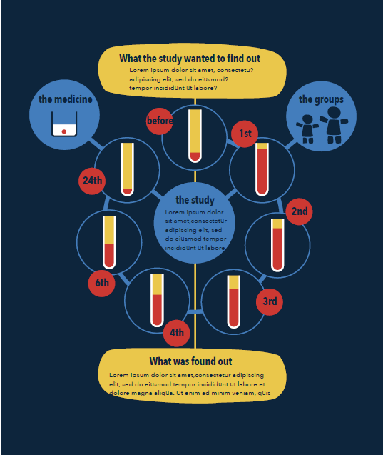
http://odysseytrial.org/

Slide 28
Backup slides

Slide 29
Short term safety
Follow up is still only short term and toxicity and efficacy monitoring is continuing.
So far only serious adverse events have been looked at, not adverse events.
4 serious adverse events have been reported and are all hospitalisations with various infections.
All look unrelated to DTG and DTG has continued in all. 2/4 have been reviewed by the endpoint review committee blind to arm.

Slide 30
Methods
Informed consent was obtained for all children
Inclusion criteria:
<18 years on the PK visit
Randomised to DTG-group in ODYSSEY A or B
Weighing 6 to <20kg
Exclusion criteria:
Illnesses that could influence PK, i.e. severe diarrhoea, vomiting, renal disease or liver disease
Concomitant medication known to have interactions with DTG
Severe malnutrition WHO Z score lower than -2
PK samples were considered not evaluable for PK analysis if:
>1 PK sample was haemolytic
>1 PK samples were missing
Adherence was questionable based on PK results (e.g. low pre-dose plasma concentration (C_{0h}) compared with C_{trough})

Slide 31
Mg/kg~AUC

Slide 32
Mg/kg~C_{trough}

Slide 33
FCT vs DT
DT is about 1.6 – 2.0 times more bioavailable than FCT
WHO weight band | 14-<20kg | 14-<20kg
Dose (mg) and formulation | 25 FCT | 25 DT
N | 19 | 13
Dose/weight (mg/kg) | 1.5 (1.3-1.8) | 1.4 (1.3-1.7)
C_{trough} (mg/L) | 0.43 (50) | 0.85 (67)
AUC_{0-24h} (mg*h/L) | 39.57 (32) | 69.5 (30)
C_{max} (mg/L) | 4.03 (31) | 7.1 (21)
Pharmacokinetic parameters are expressed as geometric mean with coefficient of variation (%), median (IQR) for age and mean (range) for dose/weight. Doses represent once daily doses, unless otherwise specified. FCT, film-coated tablet; DT, dispersible tablet. ªFasted HIV-positive adults. ^{b}Fasted healthy HIV-negative adults. ^{c}HIV-positive treatment experienced adults, fed state not specified.

Slide 34
Cmax odyssey

